Slide 1

Doing data science with F#
Tomas Petricek
tomas@tomasp.net | @tomaspetricek
PhD Student at Cambridge & Coordinator of http://fsharp.org

Slide 2
software stacks trainings teaching F# user groups snippets mac and linux community books and tutorials
F# Software Foundation
consulting open-source MonoDevelop
http://www.fsharp.org
contributions research support cross-platform mailing lists

Slide 3
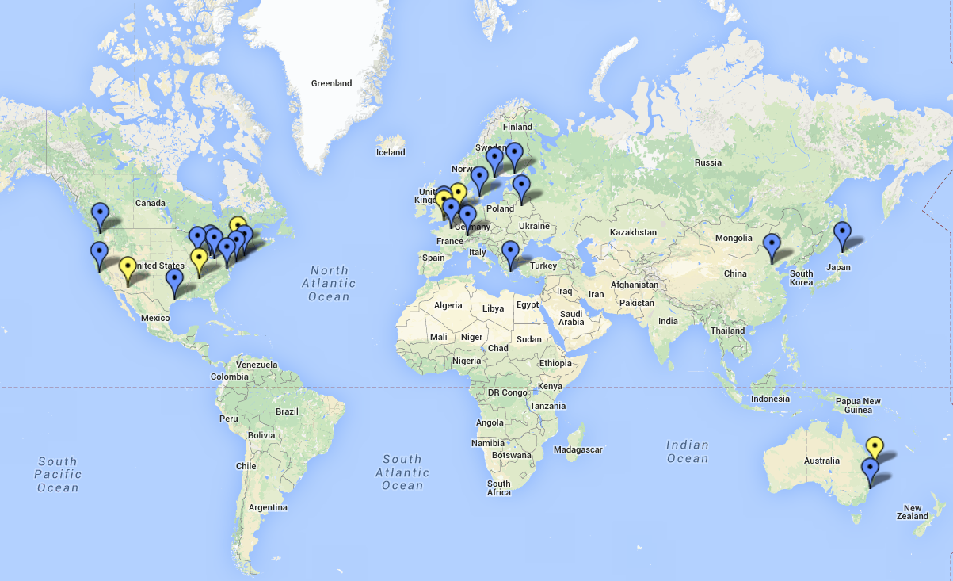
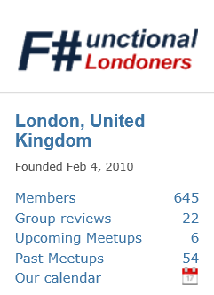
Community matters!

Slide 4

All the Data of the World

Slide 5
data acquisition statistics data cleaning machine learning data transformation visualization type providers
F# Data Science Working Group
kaggle vega grammar data sources presentation
R provider visualization
www.fslab.org
time-series data aggregation

Slide 6
Acquire
Analyze
Visualize

Slide 7

Demo: Analyzing Titanic survivors

Slide 8


Deedle data frame
Data exploration
Indexing and aggregation
F# Charting library
Simple & composable
Interactive style
www.fslab.org

Slide 9
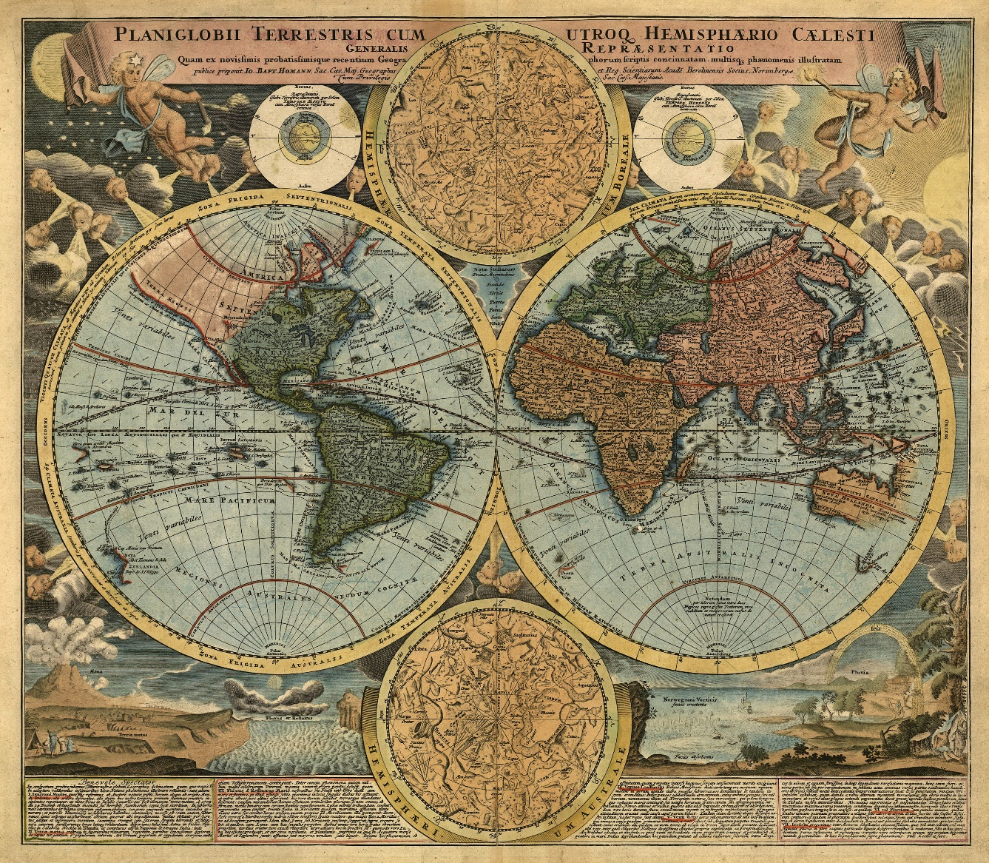
Demo: Understanding the world

Slide 10


F# Data type providers
First-class data
CSV, REST, WorldBank…
R Type provider
Statistics & visualization
5000 tested packages
www.fslab.org

Slide 11
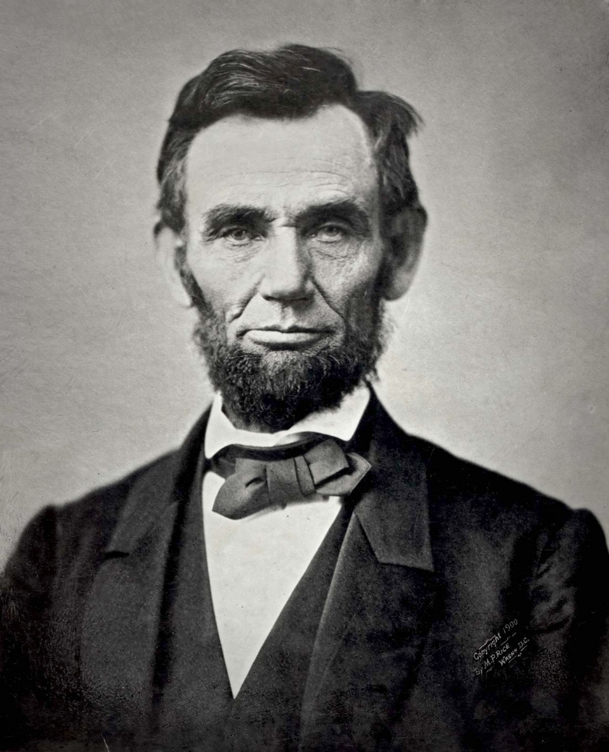
Demo: US debt over the last century

Slide 12

Deedle data frame
Time-series alignment
Data transformations
Vega visualization
F# wrapper for Vega
Pre-alpha version
www.fslab.org

Slide 13
F# for Data Science
acquire, analyze, visualize
interactive experience
safety and efficiency of .net
ready for production
@tomaspetricek

Slide 14
Going forward
Use #fsharp for fun & profit
Join local user groups
Help us build data science tools
fsharp.org | fslab.org | tomasp.net
@tomaspetricek

